Slide 1
Court Ledger - Decentralized And Tamper-Proof Solution For Storing Evidence
Tharun Kumar T (211419205308) Benitha Christinal.J M.TECH.,(Ph.D.,)
Yogesh Y (211419205309) ASSISTANT PROFESSOR
Hemnath V (211419205304) SUPERVISOR

Slide 2
ABSTRACT
Court Ledger is an open-source blockchain application created to modernize and protect the administration of court data.
The blockchain's immutability and invulnerability are put to use here to keep court documents incorruptible and easily accessible to legitimate users.
Court Ledger eliminates the need for time-consuming and prone-to-error manual record-keeping by keeping track of and updating court records in real time. Furthermore, the system protects sensitive information while allowing authorized users (such as judges, lawyers, and litigants) access to court documents.
Court Ledger has the ability to completely change the way courts handle their case files by providing a streamlined, easy-to-use platform for doing so. This abstract introduces the Court Ledger system, describing its features and describing its possible uses in the context of court record administration.

Slide 3
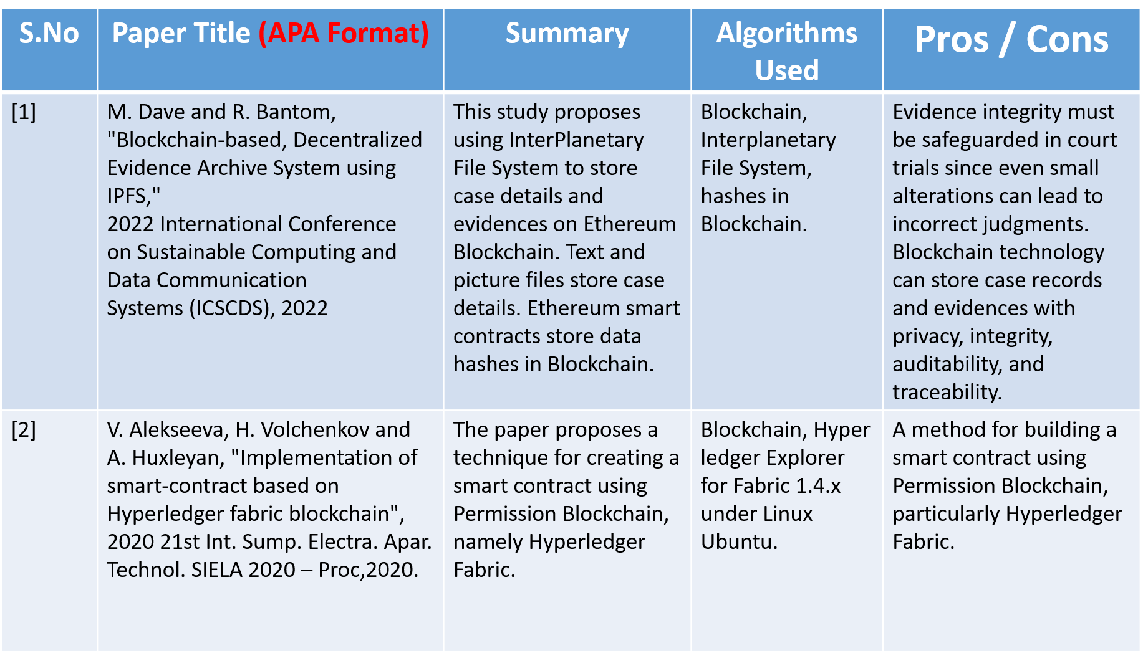
LITERATURE SURVEY
S. No | Name of the paper with year | Objective | Pros | Cons

Slide 4
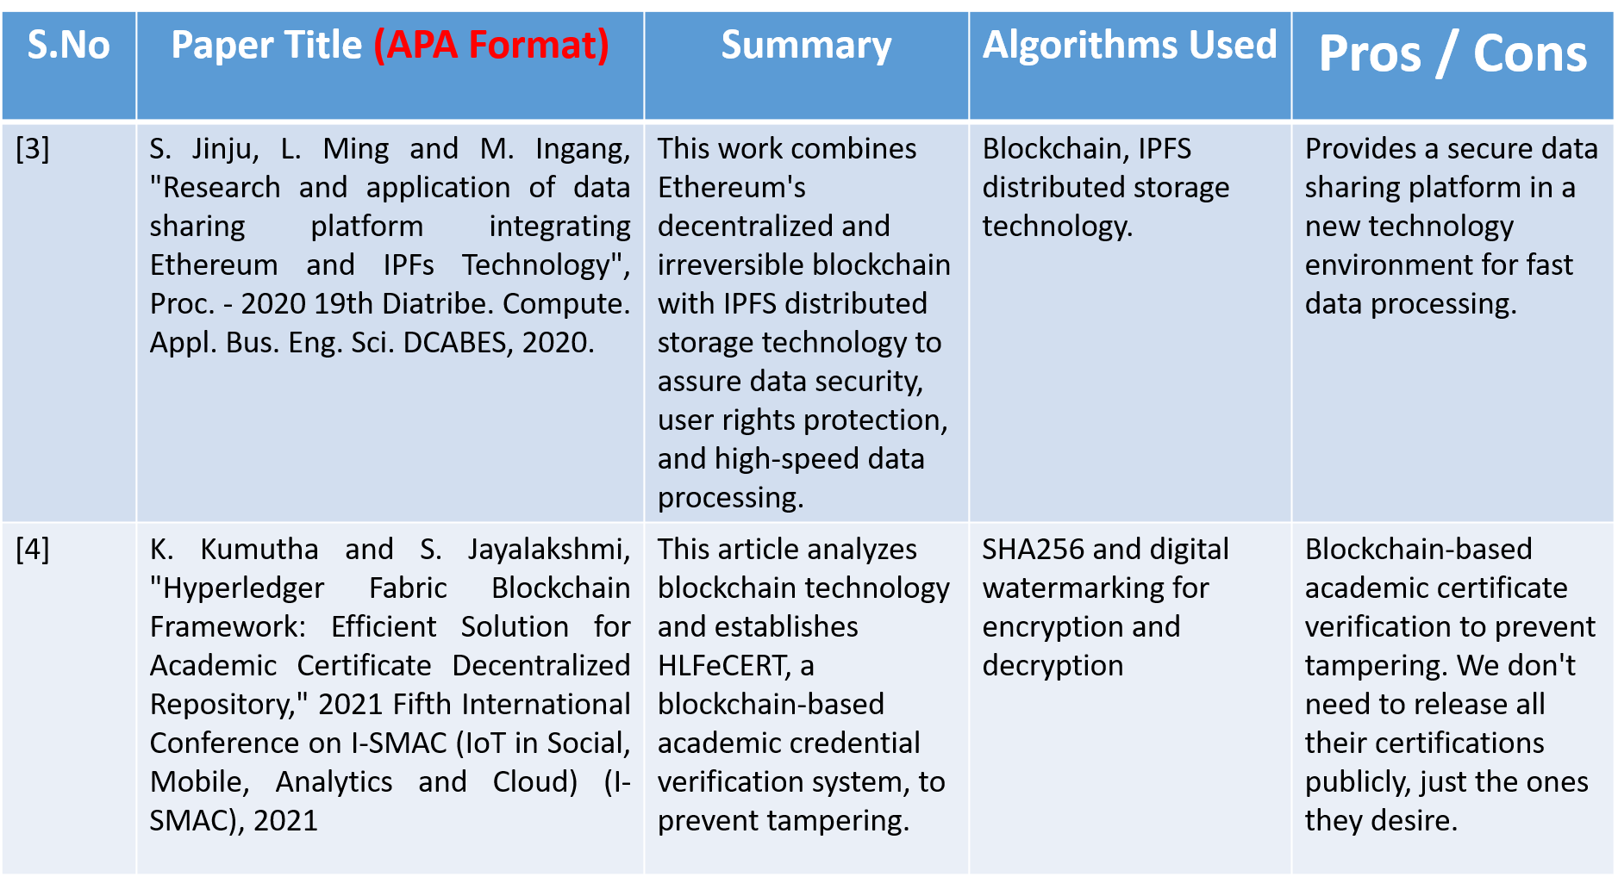
LITERATURE SURVEY
S. No | Name of the paper with year | Objective | Pros | Cons

Slide 5
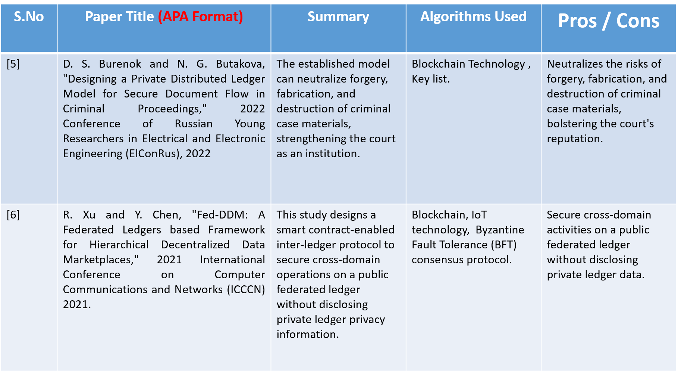
LITERATURE SURVEY
S. No | Name of the paper with year | Objective | Pros | Cons

Slide 6
EXISTING SYSTEM
The Existing System was establish in 2020 by British judicial using blockchain technology.
Even though the files are encrypted there are many flaws in the management of ledger.
The transparency was low and lack of private key attack of evidence was high.
The verification of evidence after uploading is low.
The existing system dosen’t have a dedicated admin system for managing the entire system .

Slide 7
PROPOSED SYSTEM
In order to implement Court Ledger, a number of crucial parts would need to be in place. To begin, a blockchain network would be utilized because of its immutability and tamper-proof nature, both of which are essential in the management of court data.
After that, the system would provide a safe way for court staff to enter data and administer case files. There would be less room for human mistake and unnecessary paperwork if court documents could be tracked and updated in real time using this interface.
A secure access control method would enable only authorized users, such as judges, lawyers, and litigants, to see case files, protecting the confidentiality of sensitive data.
In addition, the system would promote openness in the administration of court records by enabling authorized parties to monitor the status and revisions of court documents.

Slide 8
PROPOSED SYSTEM
Strong encryption techniques to safeguard sensitive information and the implementation of suitable security measures to prevent unauthorized access and cyber-attacks are required to guarantee the security and integrity of the system.
In order to ensure the safety and efficiency of court record keeping, the proposed system for Court Ledger would employ a blockchain network, secure interfaces for court personnel and authorized parties, real-time tracking and updates, access control mechanisms, transparency, and appropriate security measures.

Slide 9
SOFTWARE REQUIRMENTS
Operating system : Windows7 (with service pack 1), 8, 8.1 and 10
Language : Java Script
Technology :Block Chain
Network :Meta Mask, Bloxberg

Slide 10
HARDWARE REQUIRMENTS
Processor : Pentium Dual Core 2.00GHZ
Hard disk : 120 GB
RAM : 2GB (minimum)
Keyboard : 110 keys enhanced

Slide 11
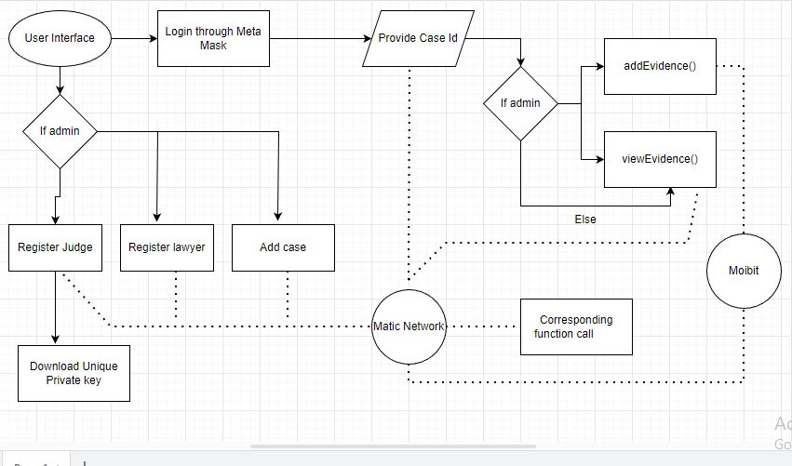
ARCHITECTURE DIAGRAM

Slide 12
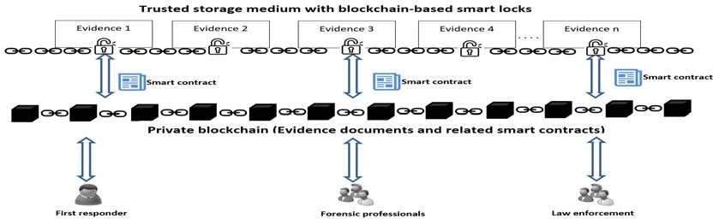
WORKING MODULE

Slide 13
ALGORITHM
Here we use different algorithms for more efficient hashing function called IBFT and RAFT algorithms
IBFT – Istanbul Byzantine Fault tolerant
RAFT-Reliable ,Replicated ,Redundant and Fault-tolerant.
The main difference between the IBFT and RAFT algorithms is that while in RAFT followers blindly trust their leader, in IBFT each block requires several rounds of voting by a set of validators to reach consensus, which is recorded as a collection of signatures on the block's content. . The validator never assumes that the leader is honest. Instead, it validates the proposed block just like any other consensus platform deployed on a trustless environment like Proof-of-Work.
As a result, RAFT consensus will not confirm blocks unless there are pending transactions, which leads to significant storage efficiency, as no empty blocks containing zero transactions are committed to the blockchain. In addition, RAFT has a faster block time compared to IBFT, with the leader validating a block within
50ms of receiving a transaction. With RAFT, majority vote confirmation is also a very fast process, as average block times are typically in the sub second range under typical network conditions.

Slide 14
MODULES
EVIDENCE STORAGE
Our system relies heavily on the Evidence Storage Module, which provides a streamlined, distributed, and tamper-proof means of preserving evidence for use in legal processes. Court hearings, evidence, and other important documents will be archived in digital form on Moibits decentralized storage and made available to authorized users using this module.
Each piece of evidence that is kept on the system must be completely safe from tampering, and this module was made to guarantee that. The Ethereum blockchain, which serves as an immutable and transparent log of all transactions and data saved on the network, is integral to this goal.

Slide 15
MODULES
BLOCKCHAIN INTEGRATION
Our system relies heavily on the Blockchain Integration Module, which provides a straightforward, distributed, and tamper-proof means of archiving evidence for use in legal processes. This component is in charge of connecting the Ethereum blockchain to the platform so that all transactions and data can be tracked and verified without any chance of alteration.
Using smart contracts, the module stores and manages information on the blockchain in a way that prevents unauthorized parties from changing or erasing it. The module's auditable history of all transactions further facilitates monitoring and vetting the legitimacy of the evidence kept on the system.

Slide 16
MODULES
USER MANAGEMENT
Our method for preserving evidence for legal processes in a way that is easy, distributed, and tamper-proof relies heavily on the User Management Module. The admin, the judges, and the attorneys are the primary users of the platform, and all three of these groups must be registered and authenticated in order to have access to and control the evidences.
This component facilitates a safe and straightforward account creation procedure for the users of the system. Only those who have been given permission to examine the evidences kept on the platform will be able to see them after logging into the system using their unique credentials.
Controlling who can view what in the database is another function of the User Management Module. In this way, the module adds another degree of protection to the evidence by limiting access to it to those who need it. Comparable to the current process, but with far better security, the admin has the ability to put cases and evidence into the cases.

Slide 17
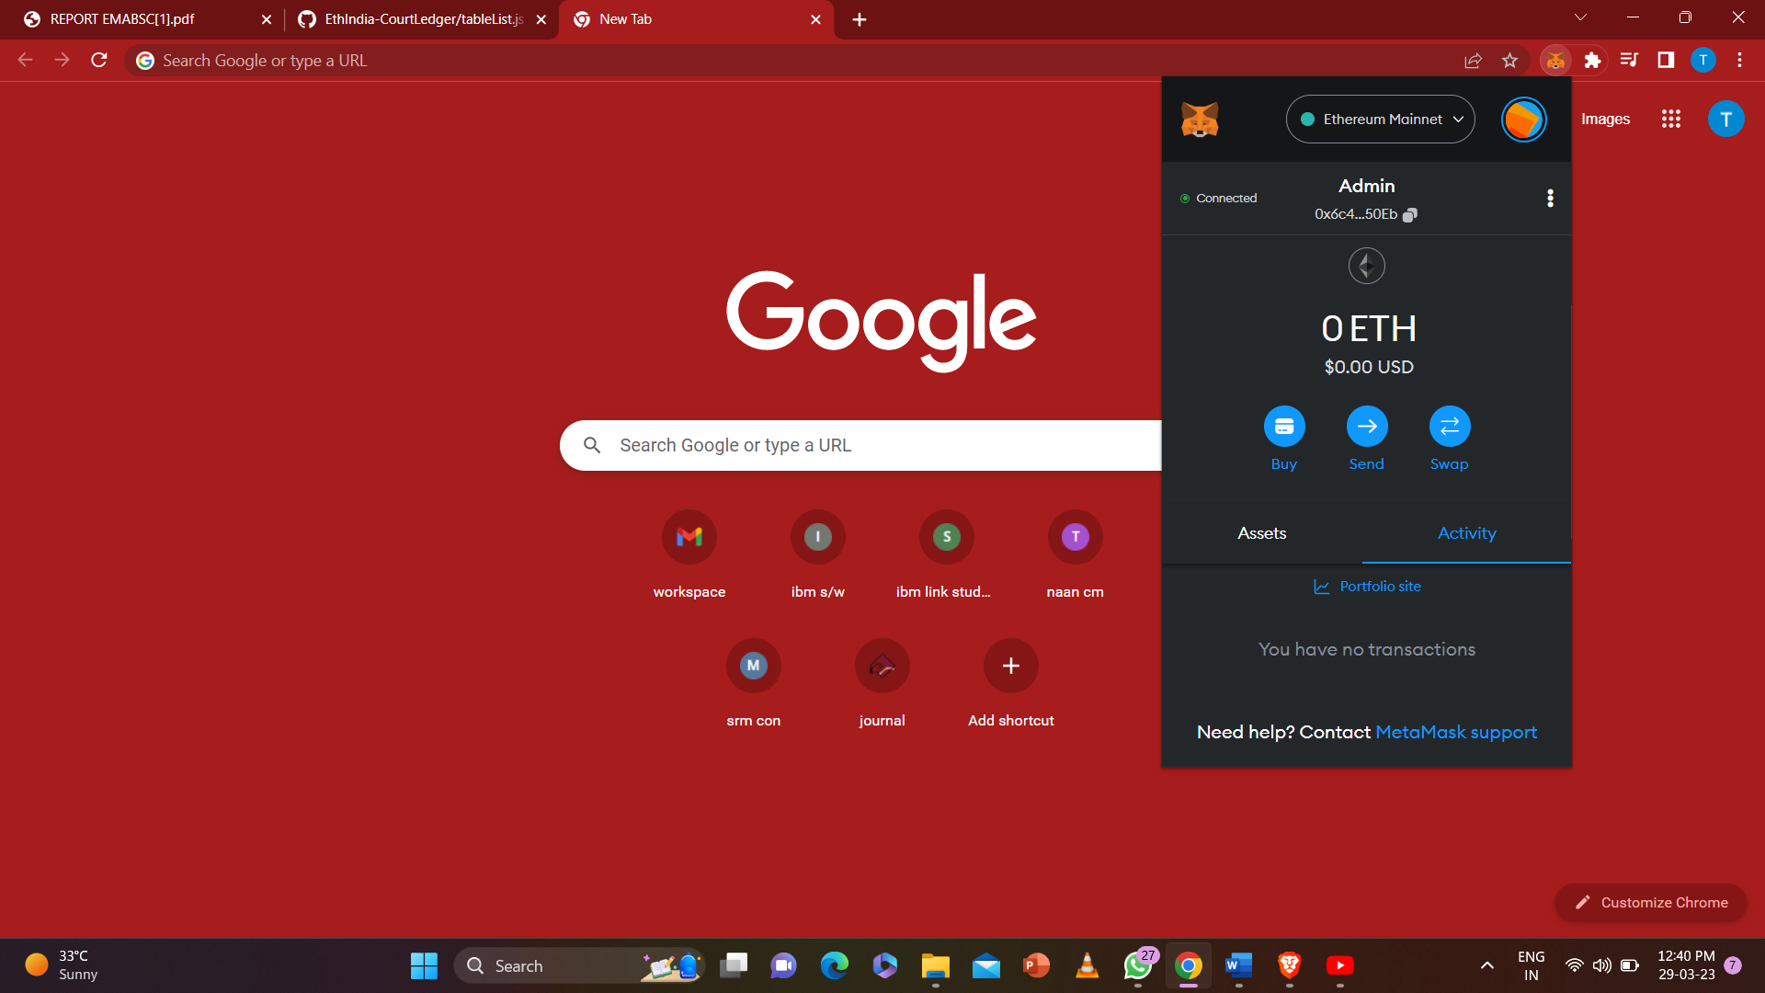
SNAPSHOTS

Slide 18
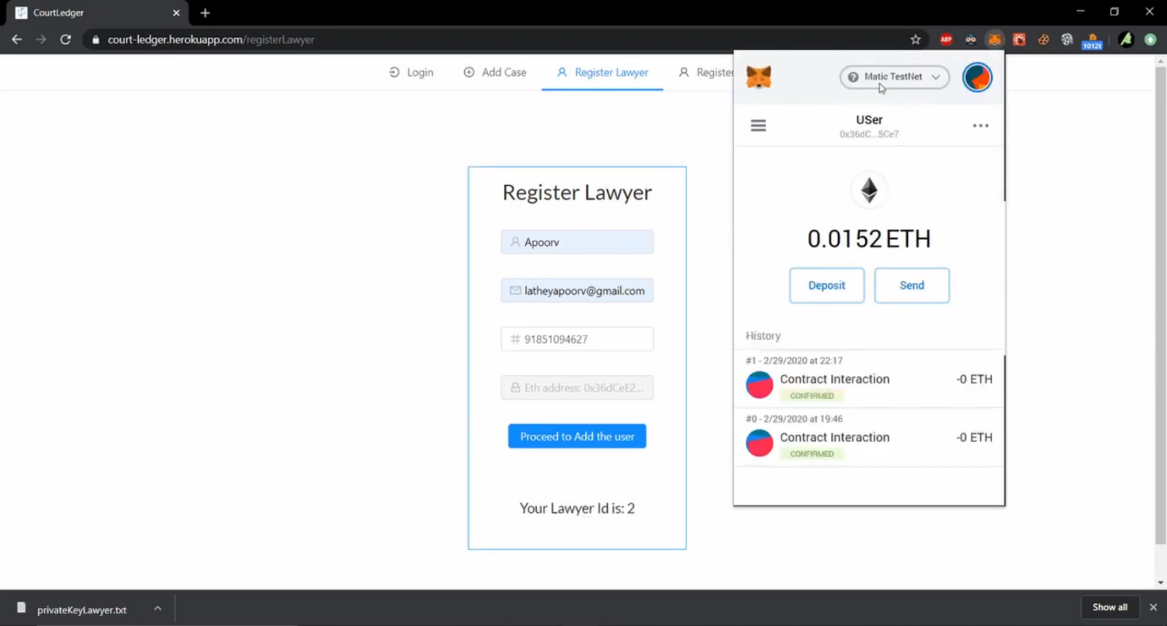
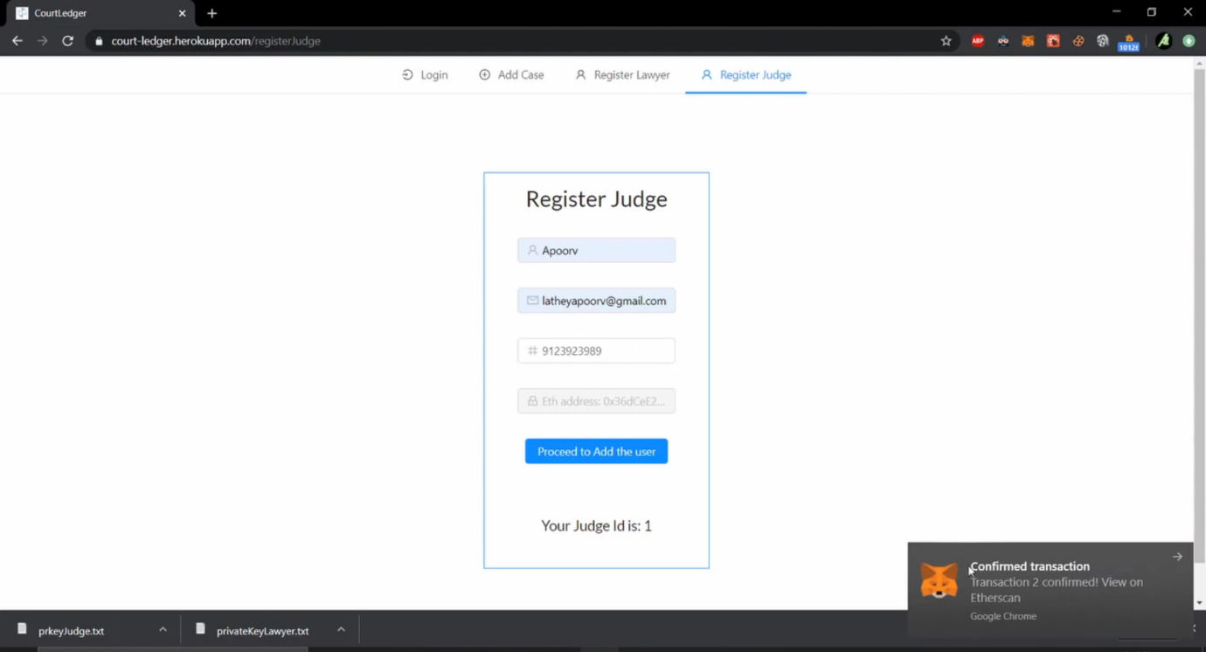
SNAPSHOTS

Slide 19
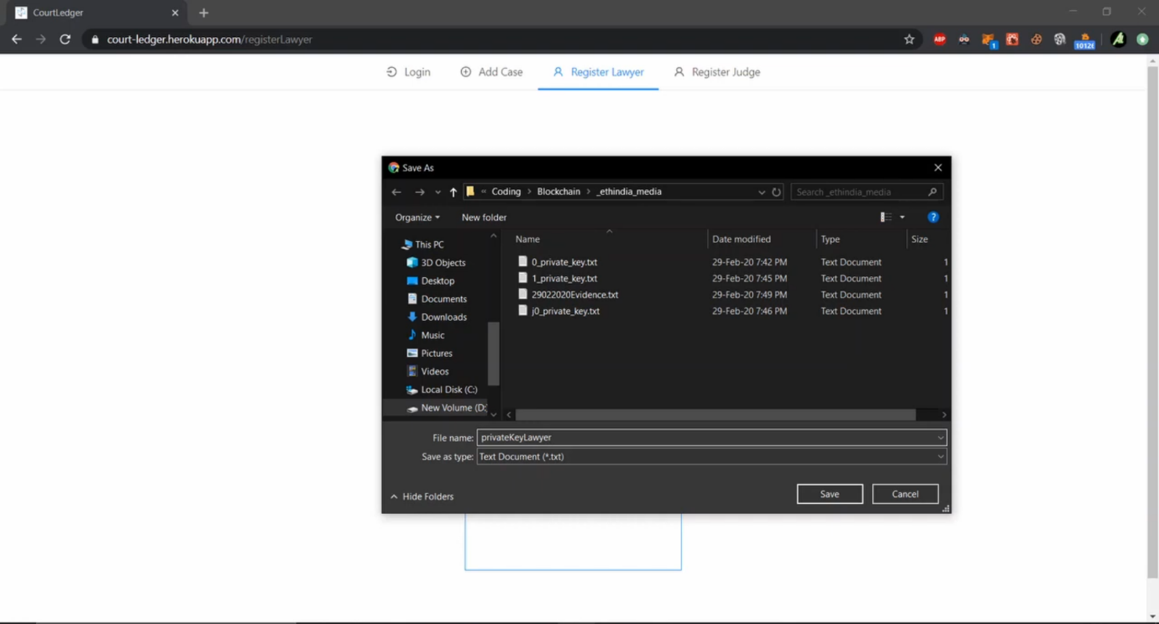
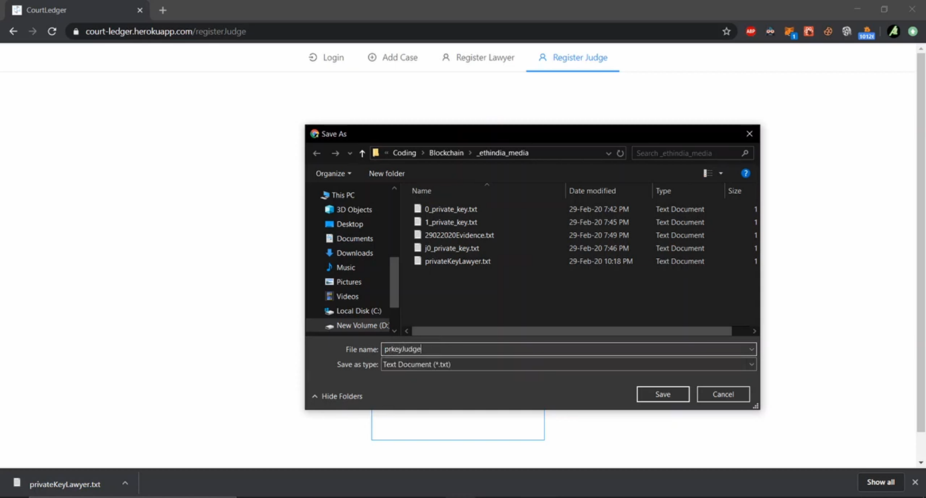
SNAPSHOTS

Slide 20
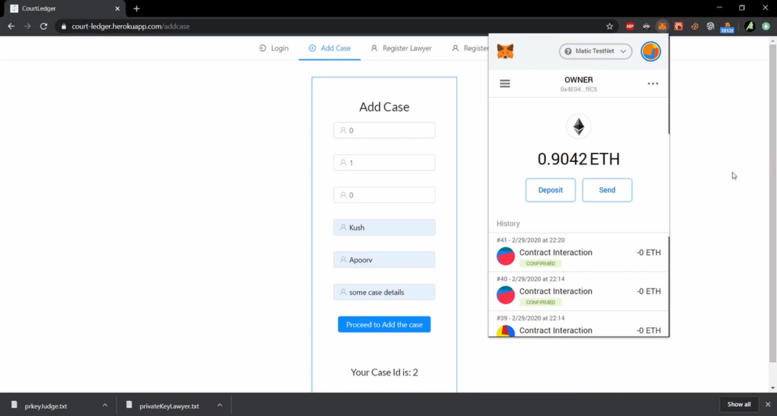
SNAPSHOTS

Slide 21
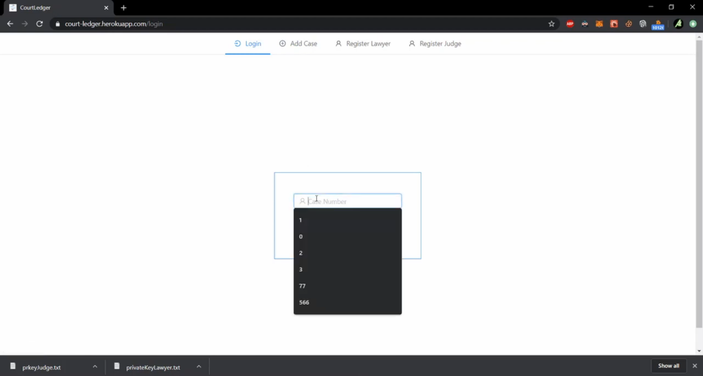
SNAPSHOTS

Slide 22
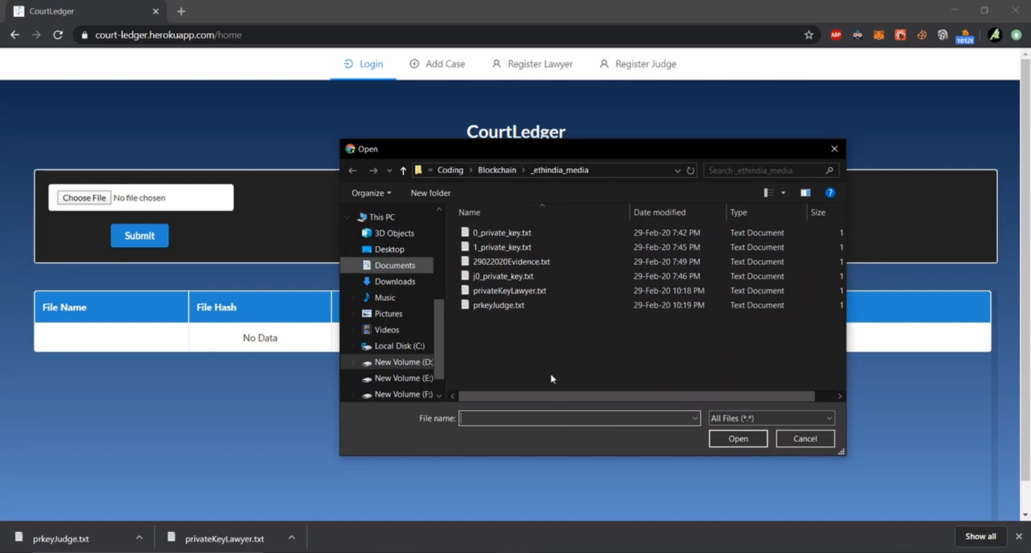
SNAPSHOTS

Slide 23
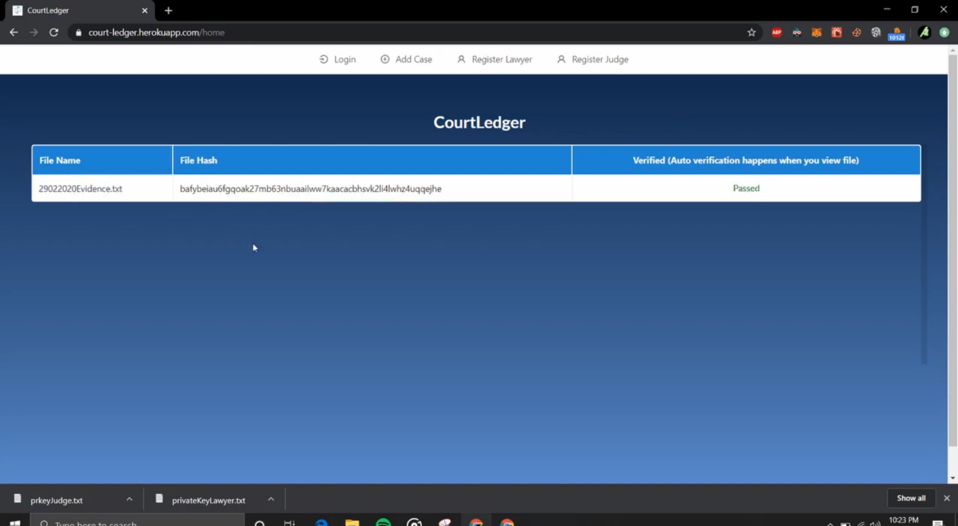
SNAPSHOTS

Slide 24
NOVELTY
The implementation of this idea using blockchain is to provide a safe secure transparent system for storing the evidence.
The novelty in this is adding double check verification encryption using 2 different algorithms.
Using of RAFT IBFT creates an great impact in security, provides full secure system with its hashing function.
The feature of private key for every user and case.
Usage of smart contract blockchain.

Slide 25
CONCLUSION
The main aim of this research was to introduce the efficient integration of blockchain technology into digital forensics. For this purpose, we have proposed a digital chain of custody framework that ensures confidentiality, integrity, traceability, and non- repudiation.
The three logical layers in the framework implement three key functionalities:
(1) the storage of evidence using blockchain-based smart locks,
(2) the storage of evidence metadata on top of a private blockchain controlled by a trusted authority
(3) the communication among involved parties using a peer-to-peer network.
The framework is implemented using Ethereum nodes and its performance has been evaluated. The preliminary evaluation results have shown that the proposed framework is able to maintain realistic workloads with an acceptable transaction throughput when compared to other consensus algorithm implementations.
The utilization of blockchain ensures evidence content integrity and its admissibility in a court of law by recording the chain of custody on an immutable network. As a future work, we plan to carry additional performance evaluation experiments and further explore the usage of blockchain technology in digital forensics in the quest for new tamper-proof and immutable mechanisms for evidence acquisition and artifact analysis.

Slide 26
PUBLICATION STATUS
2nd International Conference On Recent Advances In Electrical, Electronics, Ubiquitous Communication & Computational Intelligence - RAEEUCCI - 2.0
S.R.M ENGINEERING COLLEGE
status : Acknowledgment received / Review in process
ICICSCNT2023 R.M.K ENGINEERING COLLEGE
Status: Acknowledgment received / Review in process
ICPCSN 2023 NARASU’S SARATHY INSTITUTE OF TECHNOLOGY
Status: Acknowledgment received / Review in process
ICRAET 2023 5th INTERNATIONAL CONFRENCE ON RECENT ADVANCEMENT IN ENGINEERING AND TECHNOLOGY
Status: Acknowledgment received / Review in process
and so on..

Slide 27
REFERENCES
S. Surya, T. N. Janakiraman, and G. Chandrasekaran, "Secure Court Case Management using Blockchain," International Journal of Advanced Science and Technology, vol. 29, no. 10, pp. 3048-3055, 2020.
J. P. Singh, "Blockchain in the Legal Industry: Applications, Challenges and Opportunities," International Journal of Advanced Research in Computer Science, vol. 9, no. 2, pp. 267-273, 2018.
A. Al-Osaimi, M. S. Al-Sayed, and N. Al-Masri, "Towards Enhancing Court Procedures using Blockchain
Technology," International Journal of Computer Science and Mobile Computing, vol. 8, no. 8, pp. 47-56
2019.

Slide 28
THANK YOU

